Slide 1
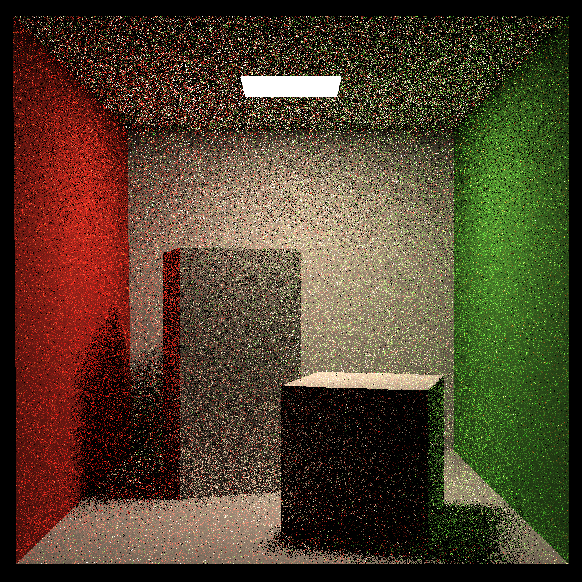
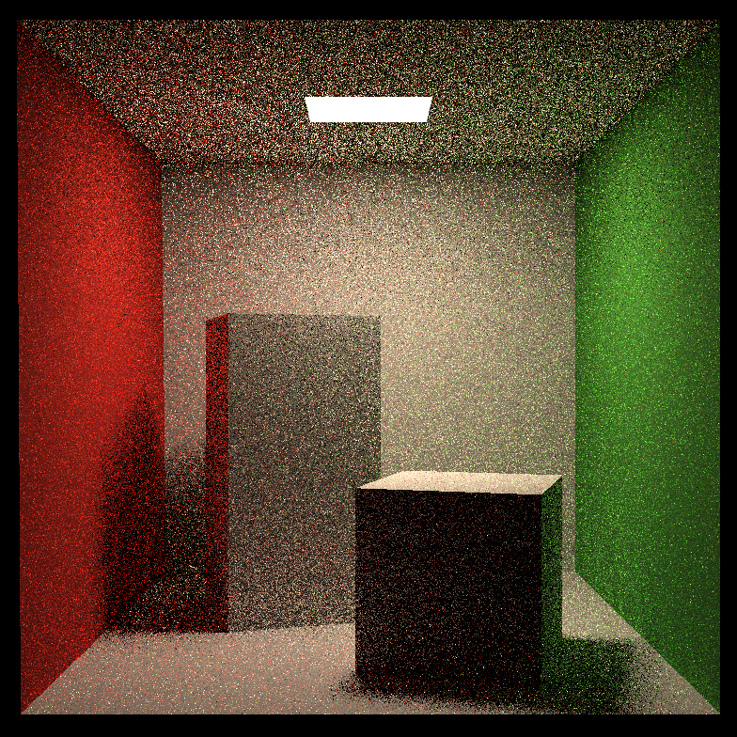
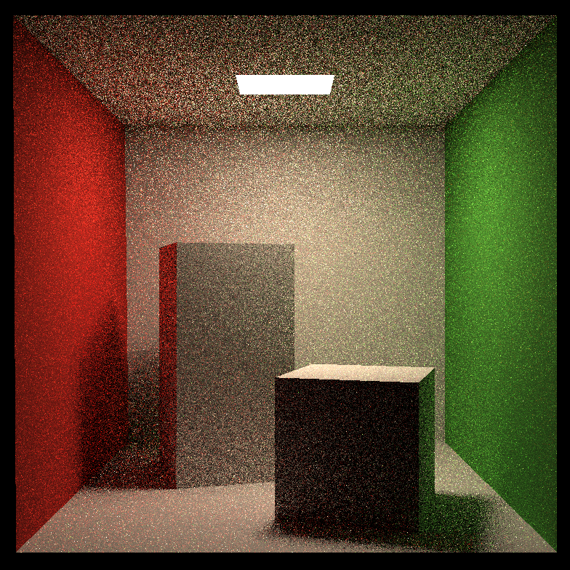
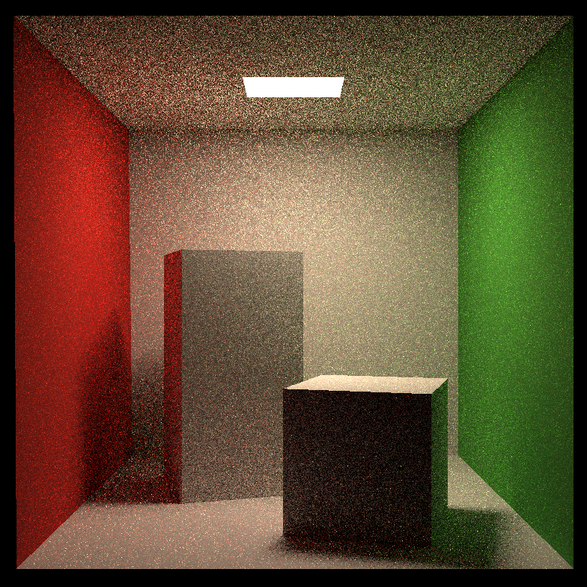
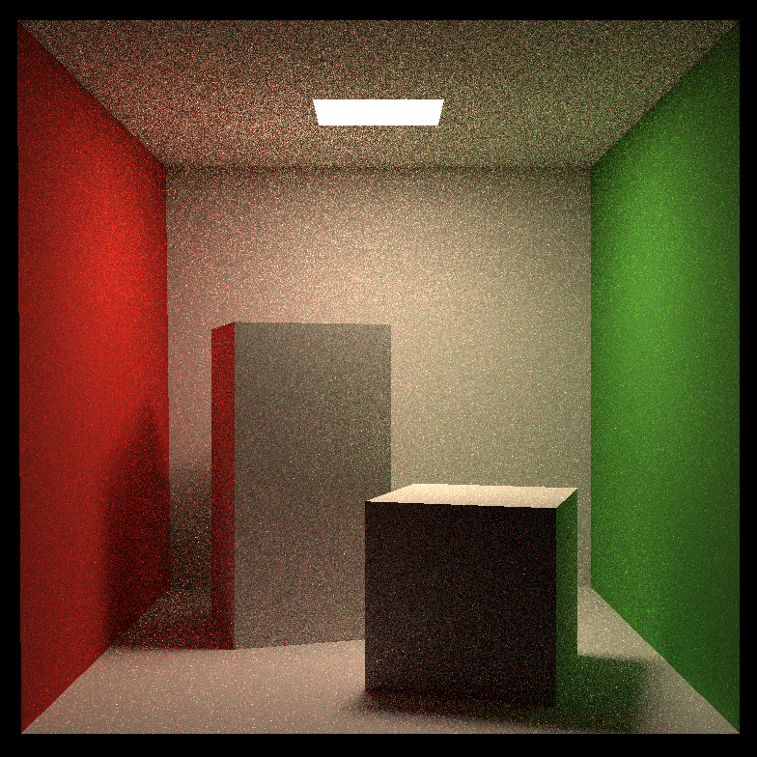
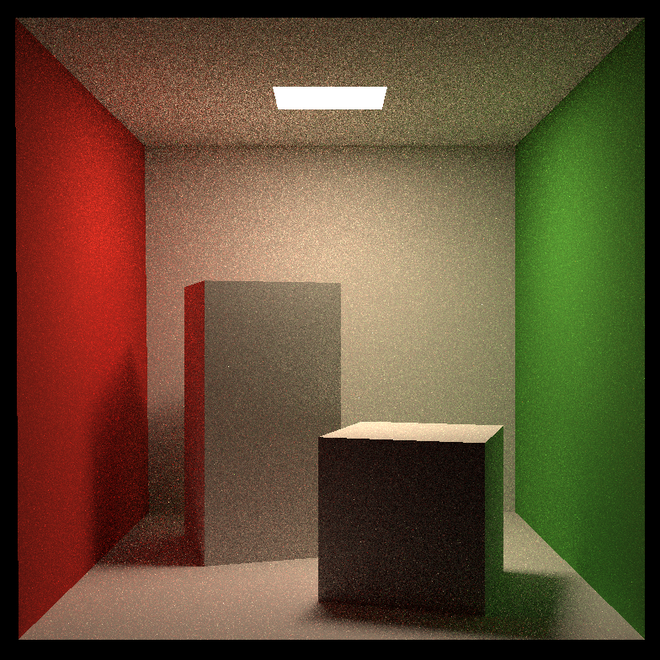


SPP = 1
2
4
8
16
32
64
128

Slide 2


SPP = 256
SPP = 512

Slide 3
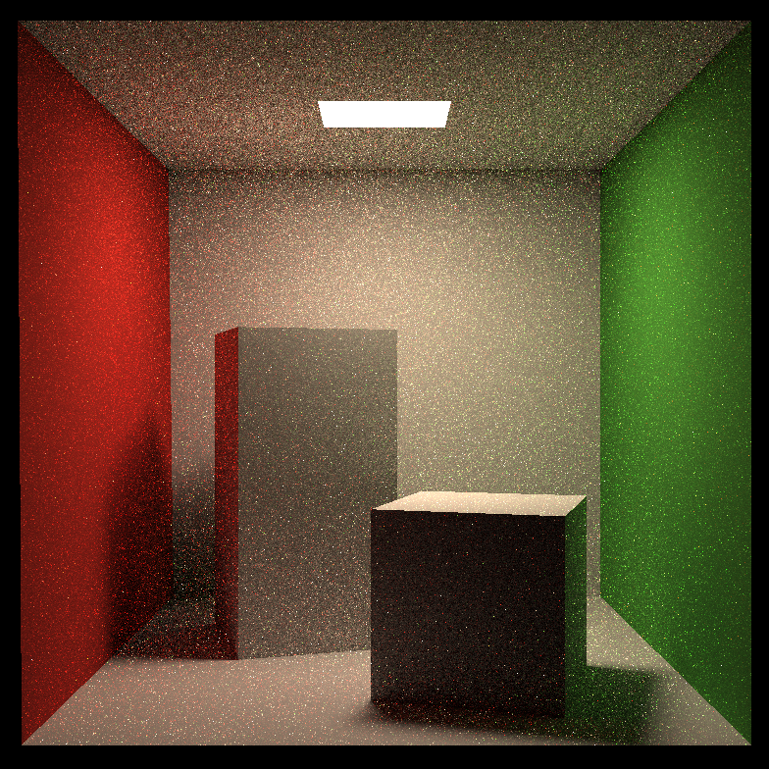


P_RR = 0.2
P_RR = 0.4
P_RR = 0.6
P_RR = 0.8

Slide 4
Testing on 256x256 scene, 128 path per pixel, 0.8 RR Probability. CPU is AMD Ryzen 5 1600 3.2 GHz
#threads | 1 | 4 | 8 | 16 | 32
time(s) | 274 | 80 | 52 | 43 | 41

Slide 5
光源2
cos theta’ = dot(n’, -w_s)
注: 框架中的w_o, w_s, w_i方向相反
光源1
@GetLeft
n’
A
cos theta = dot(n, w_s)
其他物体
n
w_s
w_o
w_i
If p emiting && depth == 0:
return p.emitting color(使光源不黑)
If p emiting && depth > 0:
return 0(对光源采样已经处理了光源射出的光)

